Slide 1


UNDERSTANDING BOOTSTRAP
For Designers
Designers’ Sharing Session at Badr Interactive

Slide 2
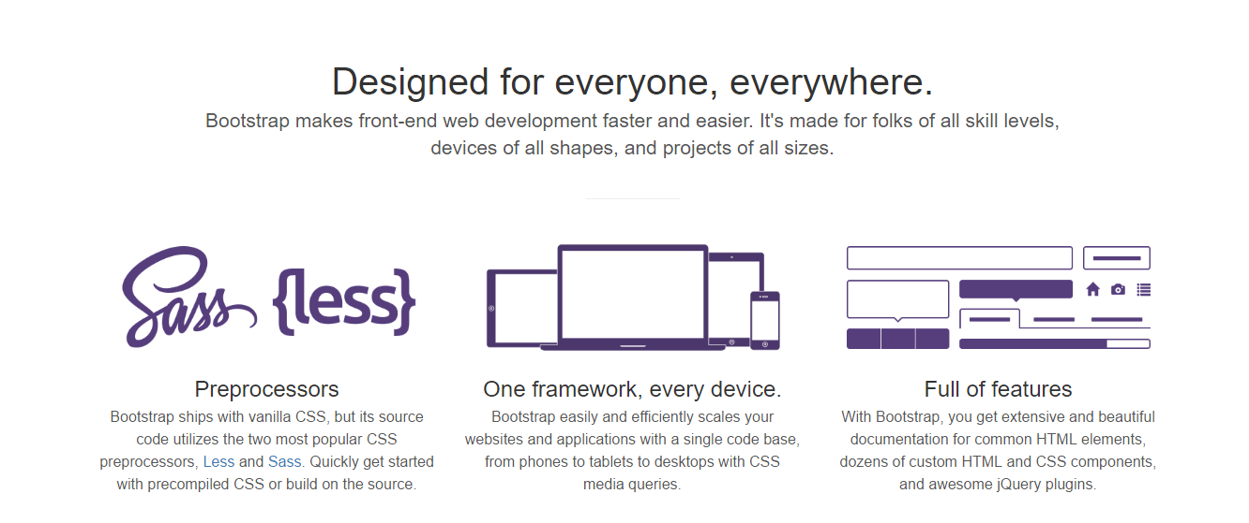

Slide 3

What is Bootstrap?
A framework combining HTML, CSS, and JS to speed up your responsive website development. Originally named Twitter Blueprint, was developed by Mark Otto and Jacob Thornton at Twitter.

Slide 4
Why Bootstrap?
Ease of use and quick to learn
Speed of development
Consistent design and common components
Wide browser compatibility
Responsive framework

Slide 5
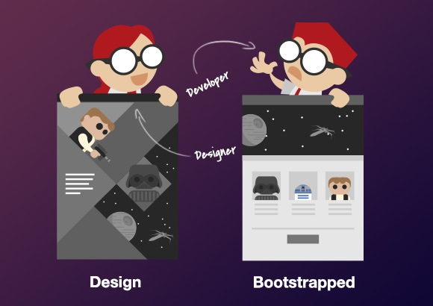
Why Not Bootstrap?
Without additional custom design work your site will look like any other site

Slide 6
Bootstrap Grid System
Used for creating page layouts through a series of rows and columns.
Rows must be placed within a .container (fixed-width) or .container-fluid (full-width) for proper alignment and padding.
Use rows to create horizontal groups of columns.

Slide 7
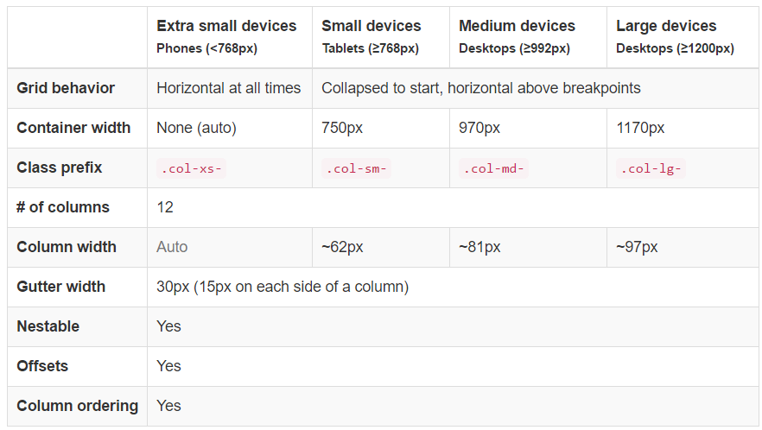
Bootstrap Grid System

Slide 8
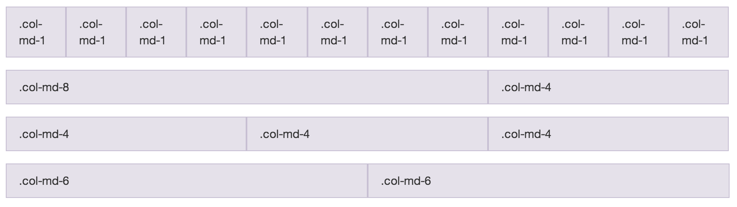
Bootstrap Grid System

Slide 9

Container vs Container-fluid

Slide 10
Bootstrap Component
Various Customized HTML Components in Bootstrap:
Glyphicons
Dropdowns
Button groups
Navs Navbar
and many more..

Slide 11
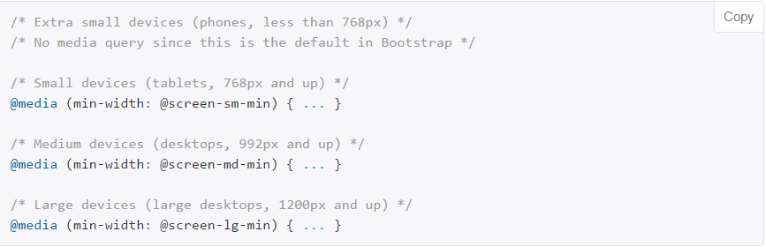
How the ‘Responsive’ works
The ‘Responsive’ Works in bootstrap via the combination of grid systems and a magic @media query:

Slide 12
Best Practice for Designer
Make use of Bootstrap grid layout and stick to it.
Use pre-defined Bootstrap component optimally.
Create a Bootstrap-based UI Guideline to ease and speed-up the development process.
Browse or research for Bootstrap-based website themes/templates
Create two UI design version: for mobile and desktop.

Slide 13
Bootstrap Showcase
http://expo.getbootstrap.com/
https://startbootstrap.com/
http://builtwithbootstrap.com/

Slide 14
Dive In More..
http://getbootstrap.com
https://gianthatworks.com/entry/bootstrap-for-designers
https://www.sitepoint.com/understanding-bootstrap-grid-system/
http://www.helloerik.com/the-subtle-magic-behind-why-the-bootstrap-3-grid-works
http://blog.jetstrap.com/2013/08/bootstrap-3-grids-explained/

